Slide 1


Analysis of Bella Beat Smart Device Usage.
User Trends, Consumer Preferences, and Recommandations to improve Bella Beat product.
By: HASSAN SAEED

Slide 2
ABOUT THE DATASET
TIME LINE
USER Information
Bellabeat is a company specializing in tech-driven wellness products specifically designed for women.
April 2016 ------ May 2016
minute-level output for physical activity, heart rate, and sleep monitoring. It includes information about daily activity, steps, and heart rate that can be used to explore users’ habits
Users Data
Established in 2013, Bella beat quickly expanded internationally, opening offices worldwide by 2016.
personal fitness tracker data of thirty three users.
Thirty eligible Fitbit users consented to the submission of personal tracker data

Slide 3
PROBLEM BELLA BEAT WANTED TO SOLVE
Bella beat wants to better understand how consumers use smart health devices in order to optimize their marketing strategies and potentially uncover new product development opportunities. Through Data Analysis it want to:
Analyze user Smart Device Usage Data.
To gain insights about how people are already using their smart devices.
Use the trends from Data that can inform Bella beat marketing strategy.

Slide 4
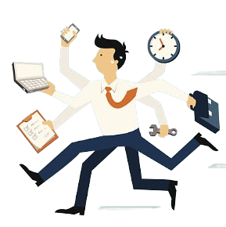
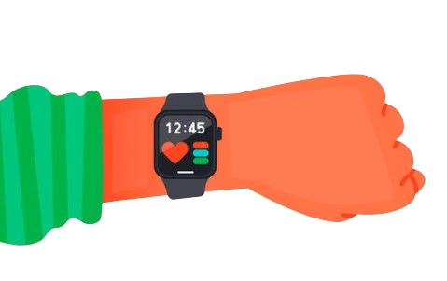
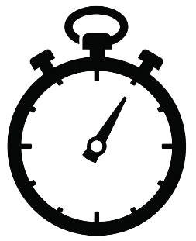
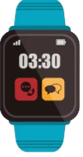
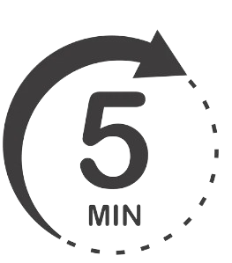
EVALUATION
Daily Actively Engaging User Over the period of time with bella beat features.
Assessed Users Engagement and trend with minutes, distance, and sleep tracker feature
Analyzed hour of the day where device usage is maximum and minimum
Analyze the Average Usage Duration of smart device features.
Interpreted the most frequently used features of smart watch

Slide 5
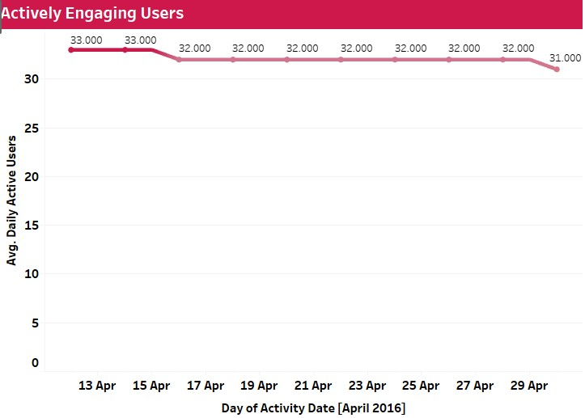
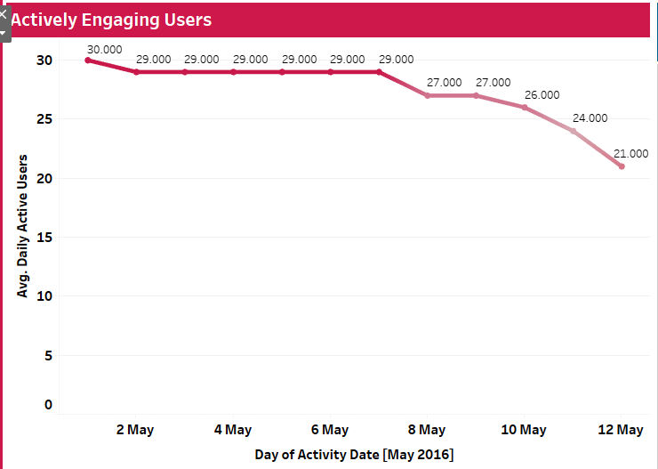
DAILY ACTIVE USERS
From 12th April up to the 12th May the number of daily active user decreased from 33 to 21. While only in the month of April there was a very slight decrease in Usage of Smart Device. In the month of May the user decrease significantly from 30 to 21.

Slide 6
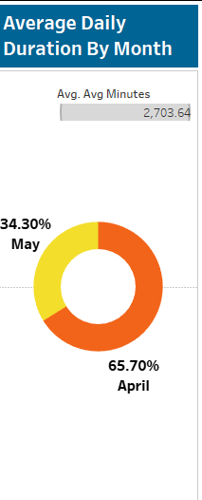

Usage Duration with Smart Device
In the month of April, each user used the smart device feature for an average of 1,377 minutes. From April to May, there were a total of 840,000 recorded sessions, representing approximately 65% of users. However, in May, usage dropped with only 34% of users (420,000) actively using the smart device. The average usage time per user in May decreased slightly to 1,326 minutes.

Slide 7
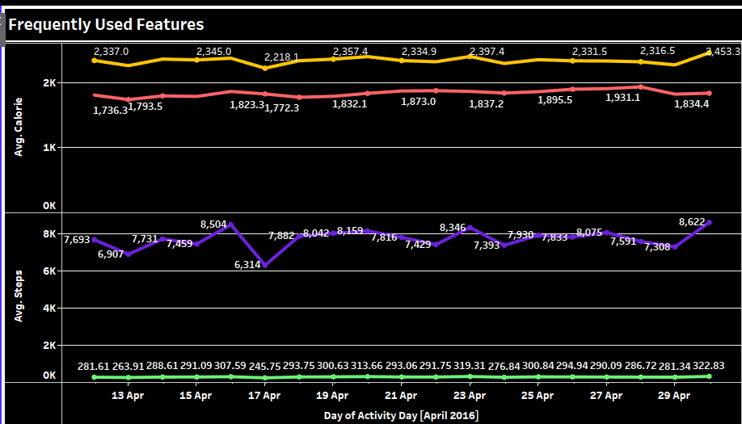
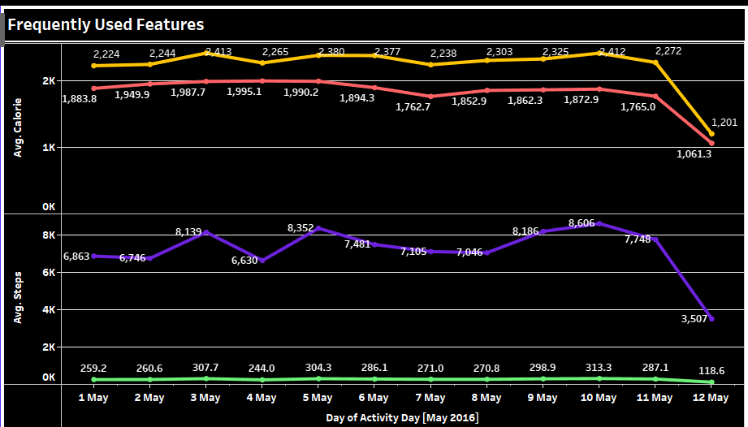
Most Frequently Used Features
The trend in usage patterns clearly shows that users constantly use the calorie and steps features. This means users consistently count their steps and calories every day, but their average intensity of movement and heart rate is very low. In April, each user's calories burned, heart rate, number of steps taken each day, and intensity of movement were increasing at a very high frequency. But in May, as the number of users dropped significantly, the average calorie burn, heart rate, steps, and intensity also decreased.

Slide 8
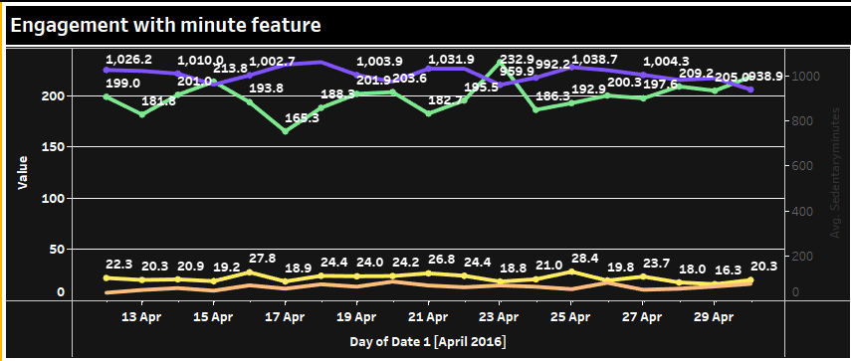
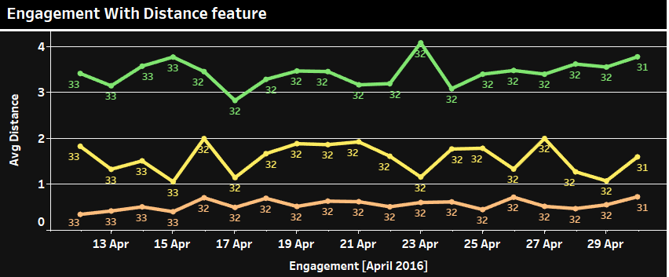
Engagement with device features In April
In April, users spent most of their time sitting, averaging between 1,000 and 938 minutes per day. Light movement accounted for an additional 199 to 205 minutes daily. Very active movement was minimal, ranging from only 19 to 28 minutes and varying between users. Despite this, user engagement with the distance feature was high. On average, users covered a light distance between 2.8 and 4 kilometers, with some variation between individuals. Very active distances were lower, averaging between 1 and 1.9 kilometers and also varying between users. Moderate distances fell within a range of 0.3 to 0.7 kilometers.

Slide 9
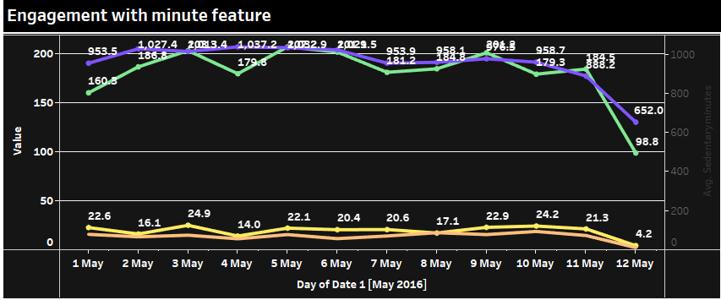
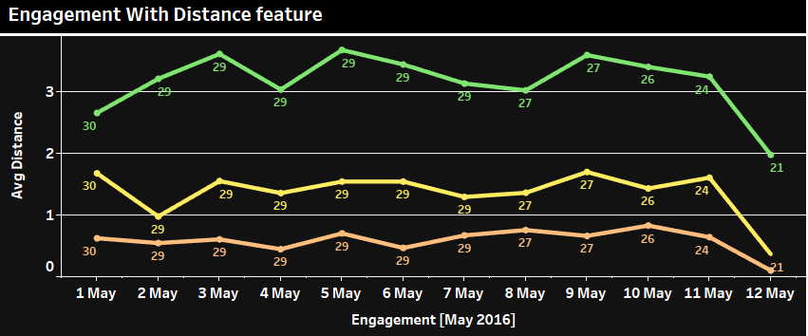
Engagement with device features In May
In May, we saw a significant decline in engagement with the minute and distance features, as evidenced by the low frequency on the line chart. Sedentary minutes decreased from 953 to 632 minutes. The timeframes for lightly active and very active minutes also decreased, dropping from 160 to 98 minutes and 22 to 4 minutes, respectively. There was also a decrease in light activity, with users averaging 3.6 kilometers per day in April and 1.9 kilometers per day in May. Similarly, highly active movement decreased from 1.6 kilometers to 0.3 kilometers, and moderate movement fell from 0.7 kilometers to 0.3 kilometers.

Slide 10
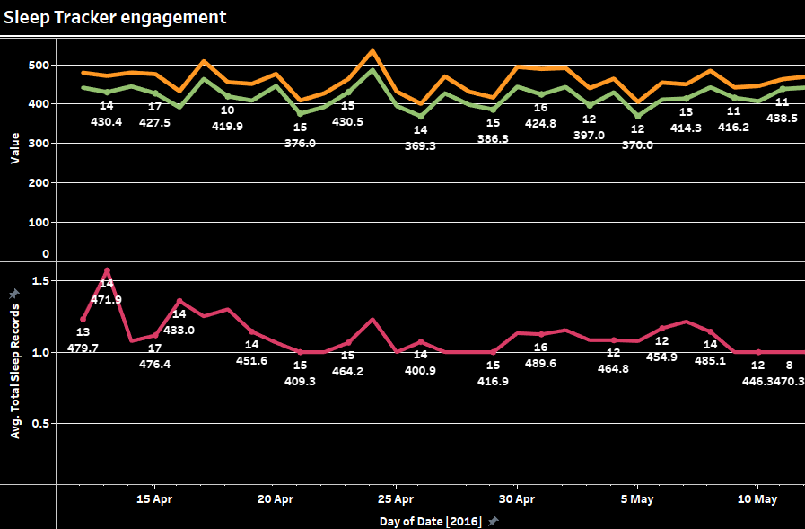
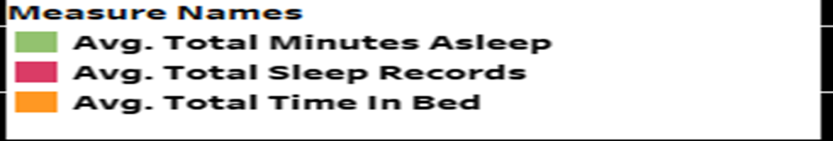
Sleeping Pattern of Users
Over the period of two months, most users had an average sleep duration between 369 and 438 minutes. They might be reading books or using their mobile phones, among other activities. Their average sleep duration varies between 1 and 1.576 minutes, with differences between users. This average gradually decreases as the overall number of users decreases.
Around 50% of user didn’t used this feature to track their sleep records from April till may.

Slide 11
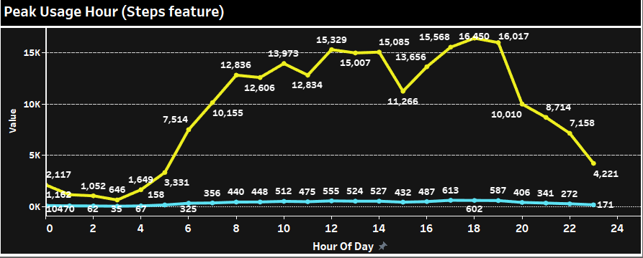
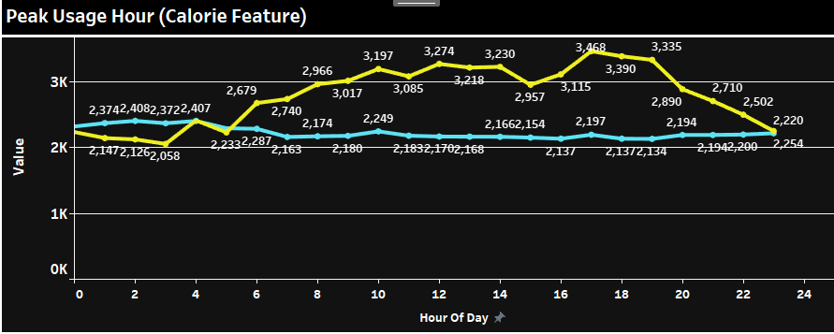
Peak Usage Hour of Smart Watch Features
From 8 am to 6 pm, the number of steps increases as men go to work, children go to school, and women do household chores. These are typical working hours. As the number of steps increases, so does the intensity of each step. After 6 pm, both the number of steps and their intensity decrease as people begin to prepare for sleep. The average number of steps ranges from 12,000 to 16,450, and the average intensity ranges from 440 to 602.
As steps and intensity increase, calorie burn also increases. Each user experiences their maximum calorie burn during peak hours of steps and intensity. However, heart rate decreases at these peak usage hours. On average, user heart rate is higher when calorie burn, steps, and intensity are lower.

Slide 12
RECOMMANDATIONS

Slide 13



Recommendation 1
Send timely reminder to user to reach their daily activity goal. This would help the user constantlyu track their engagement with the smart device and bella beat would have a more and consistent data which Company can use it for future analysis
Recommendation 2
Introduced community events, challenges, and prizes to keep user engaged with the device for example: Bella beat announces that user who has the highest engagement for whole month will get a cash prize of 500 dollars. This would motivate users to actively track their health throughout the day and number of user would increase.

Slide 14

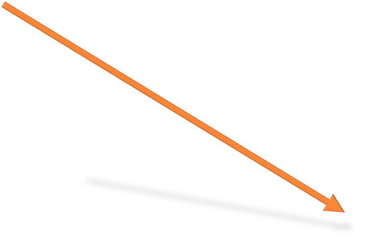


Recommendation 3
Locate areas in which these smart devices are mostly used and target people of that area through marketing campaigns. implement attractive marketing strategies that would encourage user to buy Bella beat smart device product.
Recommendation 4
Introducing a personalized AI Assistant that tracks and updates user on daily calories, steps, and provides tailored recommendations to improve sleep quality. Additionally, it suggests personalized workout sessions and sends reminders to ensure a consistent sleep schedule, such as going to bed by 10 pm and waking up at 6 am.

Slide 15

Recommendation 5
Take feedback from user who stopped using smart device through in App notifications, emails, or surveys and ask them what are the reasons that let them discontinue bella beat smart device an based on the feedback work on those areas or features of smart device.

